Slide 1
Rossmann Store Sales Prediction
EDA
Machine Learning
LSTM
Streamlit

Slide 2
Rossmann store sales prediction
Project Overview
Business objective: forecast daily sales for Rossmann stores.
Use store, promotion, holiday, competition and calendar information.
Perform exploratory analysis to understand sales and customer behaviour.
Build and evaluate a supervised regression model.
Build a two-layer LSTM time-series model.
Serve predictions through a Streamlit web interface.

Slide 3
Dataset & Features
Data Processing
Data files: train.csv, test.csv and store.csv.
Store information was merged with train/test data using Store.
Target variable for supervised learning: Sales.
Key variables include Customers, Open, Promo, StateHoliday, SchoolHoliday, StoreType, Assortment and competition features.
Date was converted into calendar features such as Year, Month, Day, WeekOfYear and DayOfYear.
Merged train/test data with store information.
Checked missing values after merging.
Converted categorical variables into numeric form for modelling.
Handled missing values before model training.
Removed Date from the final Random Forest feature matrix after extracting date features.
Created an 80:20 training-validation split.

Slide 4
HOLIDAY STATUS
HolidayStatus
After Holiday | 7809.044510
Before Holiday | 5847.562599
During Holiday | 204.183189
Normal | 6632.902947

Slide 5
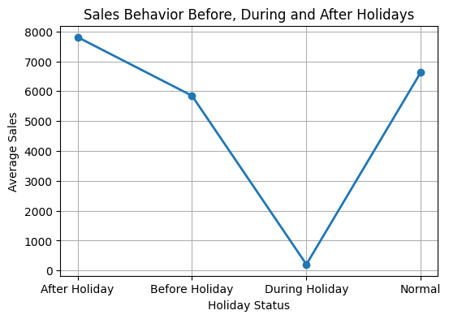
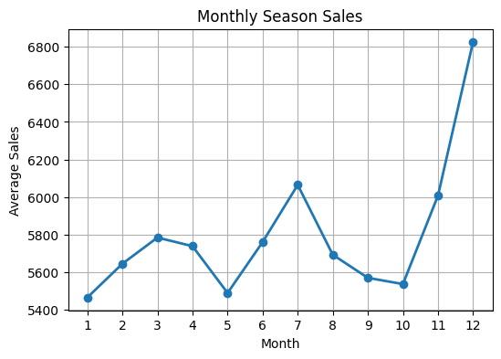
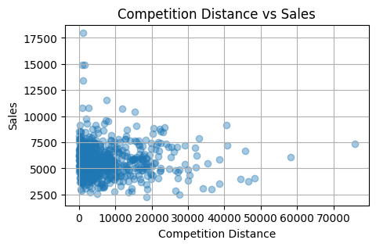
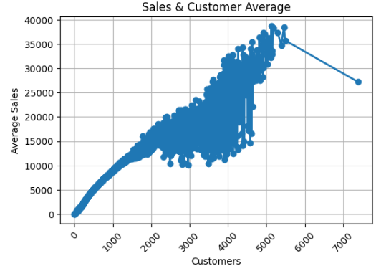
Project EDA

Slide 6
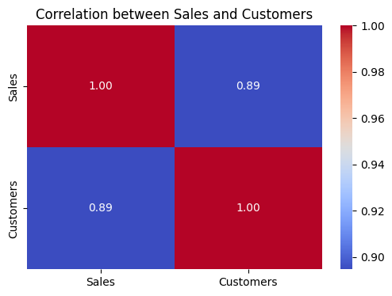
Correlation chart
Sales 1.000000 0.894711 Customers 0.894711 1.000000

Slide 7
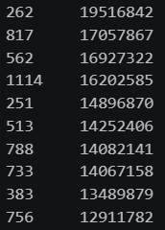
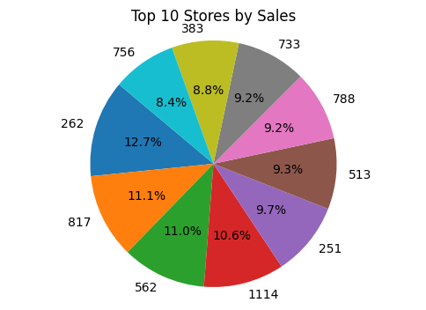
Top 10 sales

Slide 8
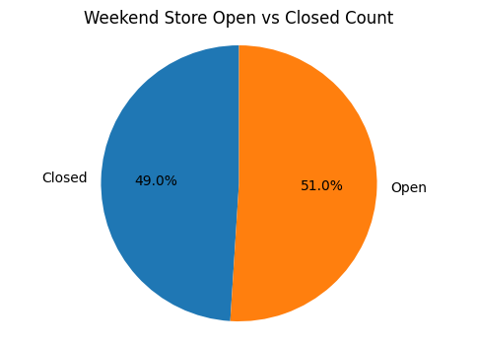
Weekend Open/Closed Count
1418091 147651

Slide 9
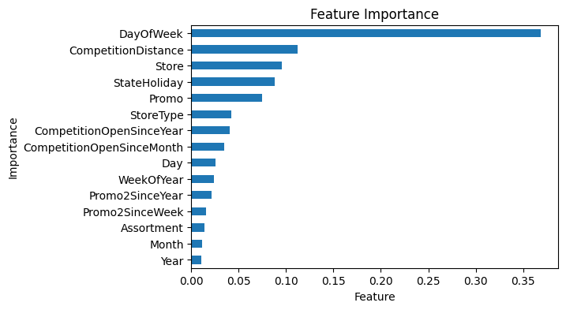
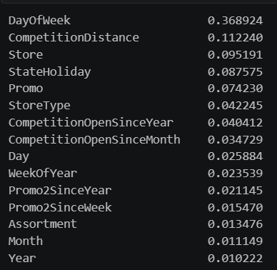
Feature Importance

Slide 10
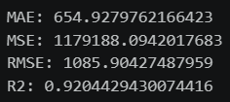
Model performance

Slide 11
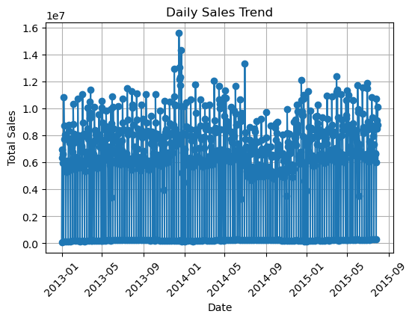
Sales Trend

Slide 12
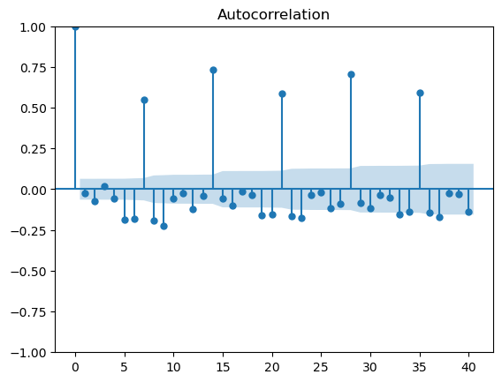
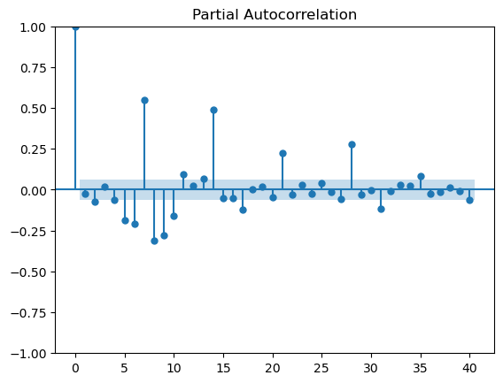
Acf & pacf plot

Slide 13
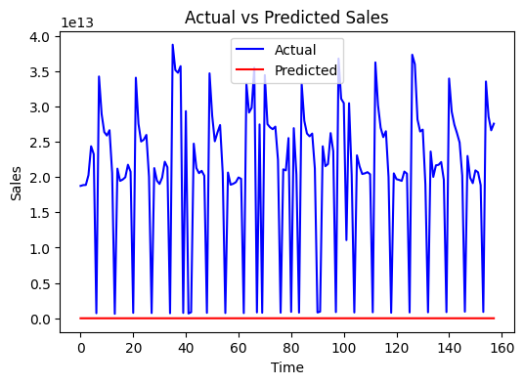
Actual vs Predicted Sales

Slide 14
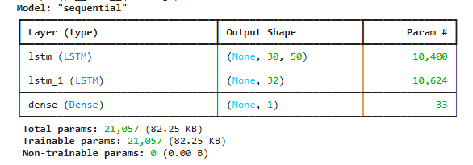
LSTM Model

Slide 15
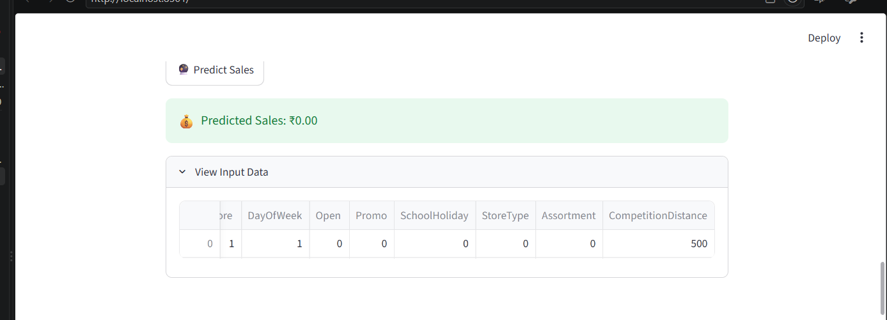
Streamlit

Slide 16
Presented By
Ruby Sethi
Thank You

